Slide 1







Interfaces, Models, and Monitoring for Resource-aware Transformations that Augment the Lifecycle of Systems (IMMoRTALS)
BBN Site Visit

Slide 2
Technology gaps addressed
How can we help developers specify the semantics of code they write?
How can we extract/infer useful information about resource use from compiled artifacts that can be used to evolve when something breaks?
How can knowledge from the various TAs be normalized for use in code synthesis/evolution?

Slide 3
What we’ve done
Created vocabulary backing a semantic specification and useful for describing scaffold code structures
Created a vocabulary for making assertions about the state of software and the ecosystem in which it executes
As they exist (descriptive)
(observed 256kbps EWMA on a network link over a 10s sliding window)
As they should exist (proscriptive) - describe problematic conditions and their implications
(bandwidth exceeded results in a constraint violation)
How to correct problematic conditions (prescriptive) - when some constraint is violated, how can it be corrected
(if a bandwidth limit is exceeded, try reducing the size of data transmitted across the network)

Slide 4
What we’ve done (cont.)
Created toolchains for
Building or extending domain ontologies using POJOs
Building scaffold (structural) models of arbitrary bytecode
Auto-generating programmer-friendly annotations that link to the semantic specification vocabulary
Discovering semantic spec annotations in compiled code and overlaying the resultant concepts on the scaffold

Slide 5
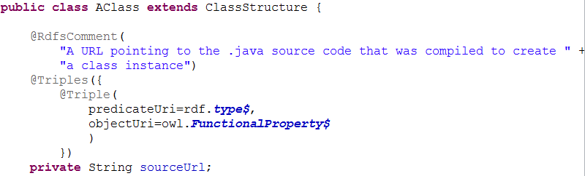
Toolchain showcase Ontology generator
Enables developers to rapidly build, populate, or extend existing ontologies using POJOs

Slide 6
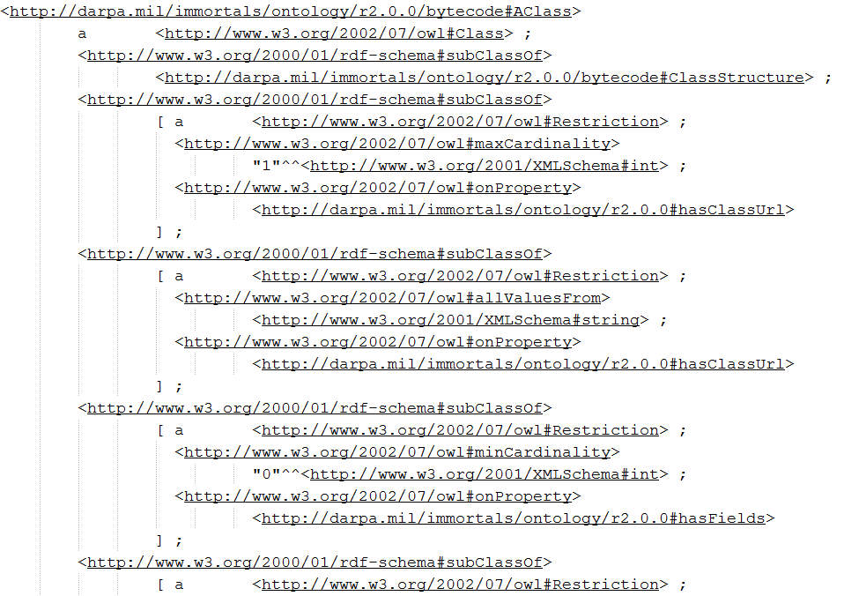
Toolchain showcase Ontology generator
Enables developers to rapidly build, populate, or extend existing ontologies using POJOs
Schema gen

Slide 7
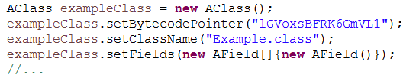
Toolchain showcase Ontology generator
Enables developers to rapidly build, populate, or extend existing ontologies using POJOs

Slide 8
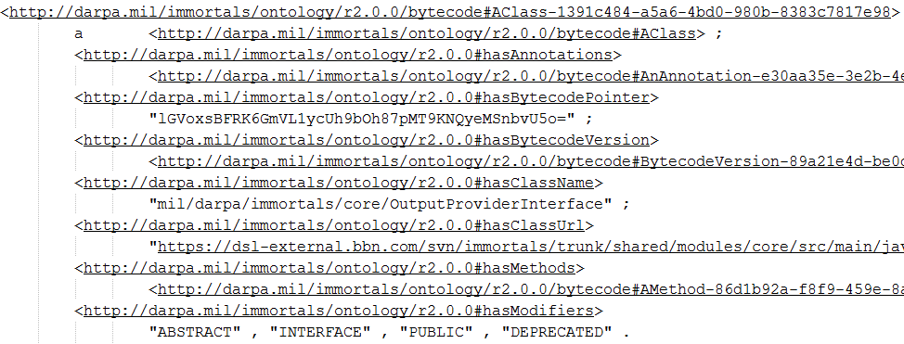
Toolchain showcase Ontology generator
Enables developers to rapidly build, populate, or extend existing ontologies using POJOs
Instance gen

Slide 9
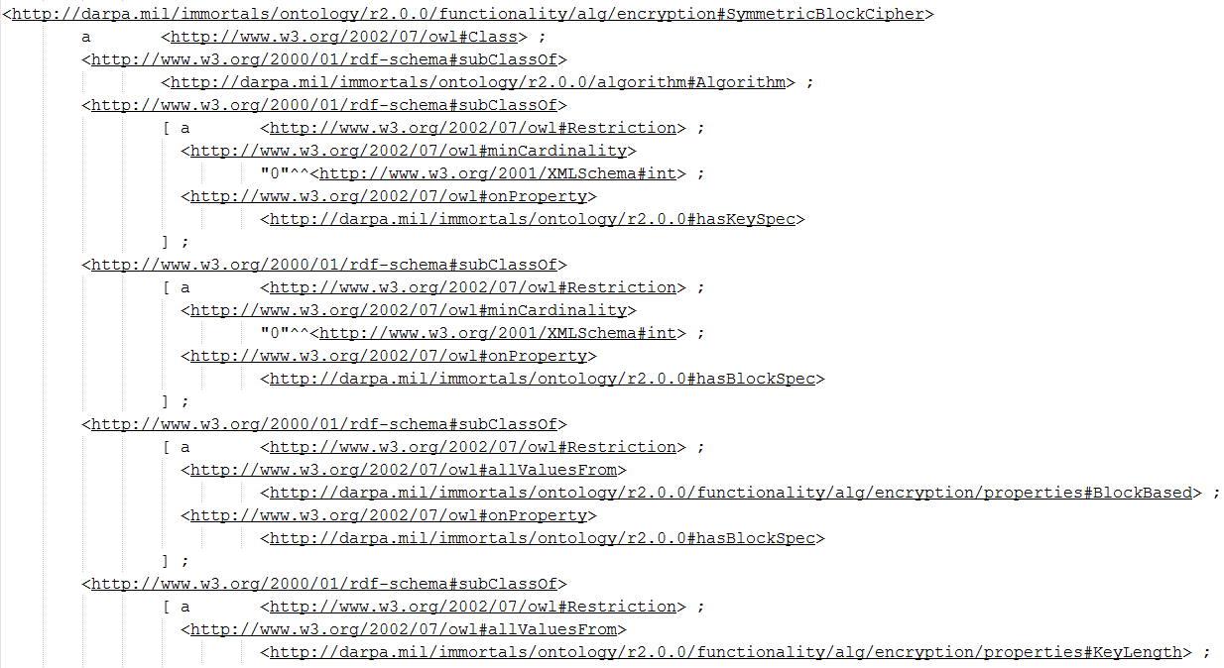
Toolchain showcase Annotation generator
From existing ontology…

Slide 10
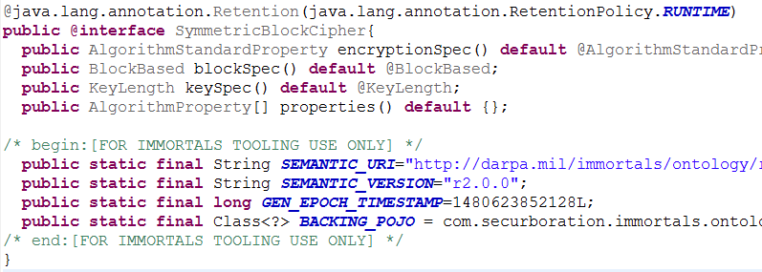
Toolchain showcase Annotation generator
…generate programmer-friendly annotations

Slide 11
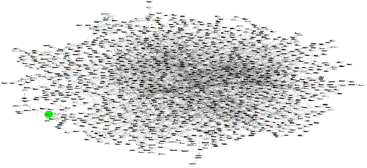
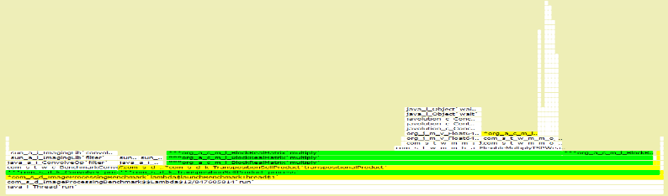
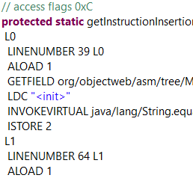
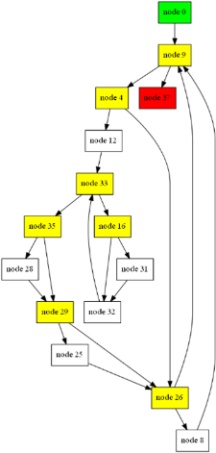
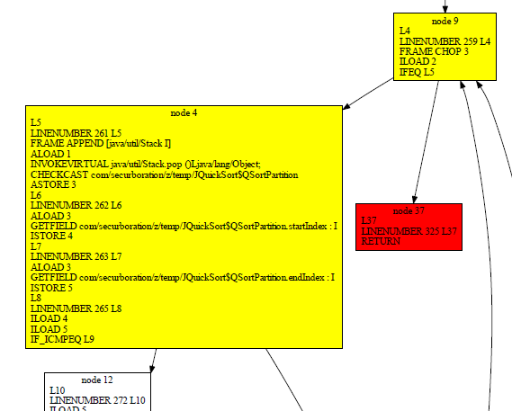
Toolchain showcase Scaffold abstractions
Dynamic analysis
abstractions
Call graph
Call trace
Compilation
abstractions
JAR
Class
Method
CFG
f
g
Basic block
p
q
Instructions
Static analysis
abstractions

Slide 12
Knowledge extraction overview
Code repo
Input option 1: complete Java project
Provided: vocabularies
.gradle
.java
Bytecode
structure
Semantic spec
.java
.java
Input option 2:
compiled bytecode
Artifact repo
jar
jar
jar
Bytecode analyzer
Resource
overlay
Semantic spec
overlay
Resource1
task1
Scaffold model
Structure +
control/data flow analysis
Resource2
task2
Resource3
task3

Slide 13
Knowledge extraction overview
Code repo
Input option 1: complete Java project
Provided: vocabularies
.gradle
.java
Bytecode
structure
Semantic spec
.java
.java
Input option 2:
compiled bytecode
Artifact repo
jar
jar
jar
Bytecode analyzer
Resource
overlay
Semantic spec
overlay
fs read
loadImage
Scaffold model
Structure +
control/data flow analysis

Slide 14
Knowledge extraction overview
Code repo
Input option 1: complete Java project
Provided: vocabularies
.gradle
.java
Bytecode
structure
Semantic spec
.java
.java
Input option 2:
compiled bytecode
Artifact repo
jar
jar
jar
Bytecode analyzer
Resource
overlay
Semantic spec
overlay
fs read
loadImage
Scaffold model
Structure +
control/data flow analysis
lossyTransformation(Resize)

Slide 15
Knowledge extraction overview
Code repo
Input option 1: complete Java project
Provided: vocabularies
.gradle
.java
Bytecode
structure
Semantic spec
.java
.java
Input option 2:
compiled bytecode
Artifact repo
jar
jar
jar
Bytecode analyzer
Resource
overlay
Semantic spec
overlay
fs read
loadImage
Scaffold model
Structure +
control/data flow analysis
lossyTransformation(Resize)
Hardware accelerator?
losslessTransformation(Encrypt)

Slide 16
Knowledge extraction overview
Code repo
Input option 1: complete Java project
Provided: vocabularies
.gradle
.java
Bytecode
structure
Semantic spec
.java
.java
Input option 2:
compiled bytecode
Artifact repo
jar
jar
jar
Bytecode analyzer
Resource
overlay
Semantic spec
overlay
fs read
loadImage
Scaffold model
Structure +
control/data flow analysis
lossyTransformation(Resize)
Hardware accelerator?
losslessTransformation(Encrypt)
network
interprocessDataflowLink(wireHttp)

Slide 17
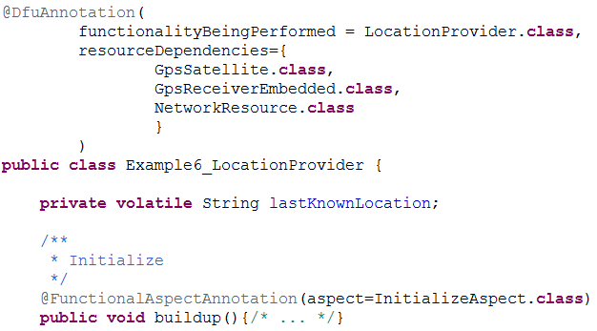
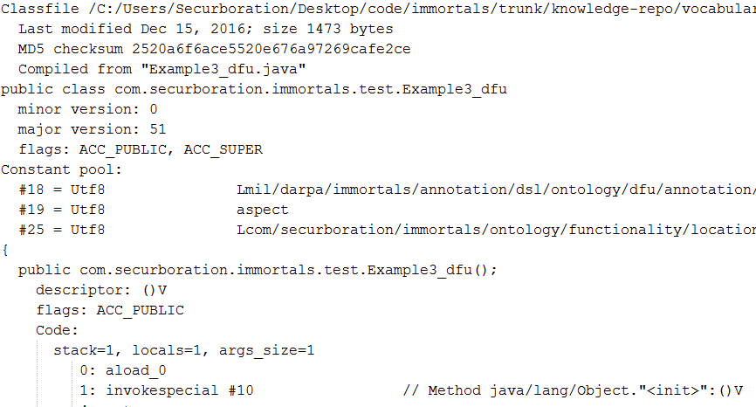
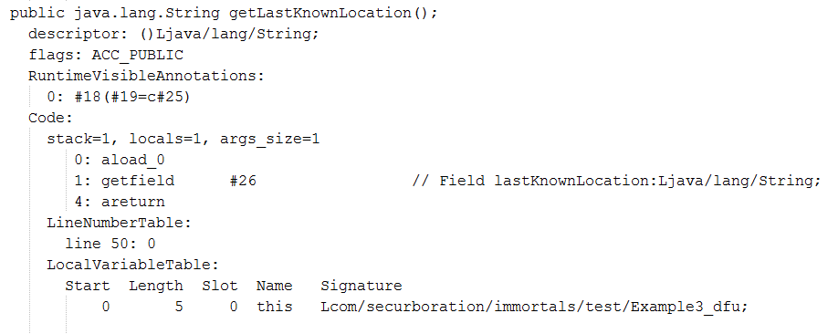
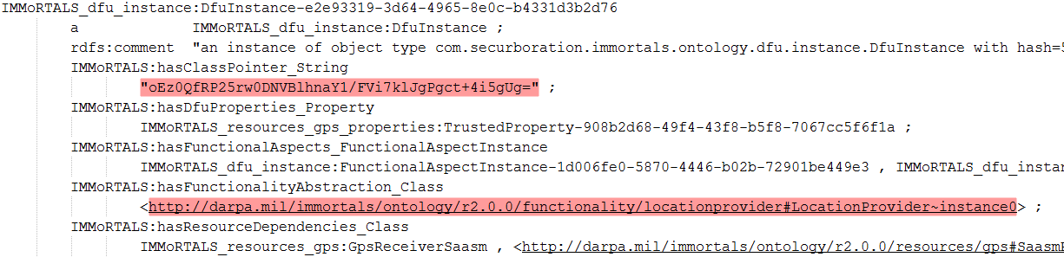
Toolchain showcase Annotation-based semantic spec
compile
bytecode
parse
knowledge

Slide 18
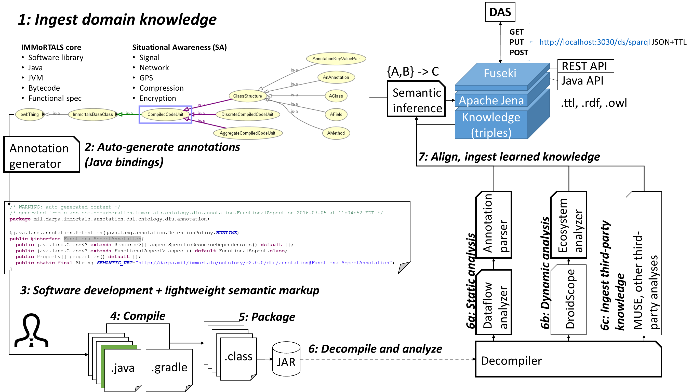
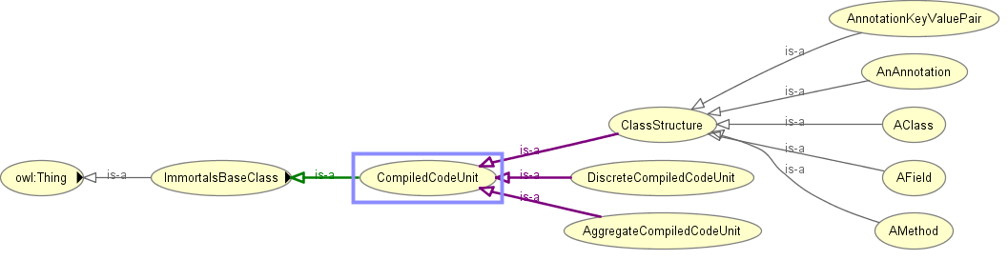

Knowledge repository CONOPs
1: Ingest domain knowledge
DAS
GET
PUT http://localhost:3030/ds/sparql JSON+TTL
POST
IMMoRTALS core
Software library
Java
JVM
Bytecode
Functional spec
Situational Awareness (SA)
Signal
Network
GPS
Compression
Encryption
{A,B} -> C
Fuseki
REST API
Apache Jena
Java API
Semantic
inference
Knowledge (triples)
.ttl, .rdf, .owl
Annotation
generator
2: Auto-generate annotations
(Java bindings)
7: Align, ingest learned knowledge
/* WARNING: auto-generated content */
/* generated from class com.securboration.immortals.ontology.dfu.annotation.FunctionalAspect on 2016.07.05 at 11:04:52 EDT */
package mil.darpa.immortals.annotation.dsl.ontology.dfu.annotation;
@java.lang.annotation.Retention(java.lang.annotation.RetentionPolicy.RUNTIME)
public @interface FunctionalAspectAnnotation{
public java.lang.Class<? extends Resource>[] aspectSpecificResourceDependencies() default {};
public java.lang.Class<? extends FunctionalAspect> aspect() default FunctionalAspect.class;
public Property[] properties() default {};
public static final String SEMANTIC_URI="http://darpa.mil/immortals/ontology/r2.0.0/dfu/annotation#FunctionalAspectAnnotation";
}
Annotation
parser
Ecosystem
analyzer
MUSE, other third-
party analyses
6c: Ingest third-party
knowledge
6b: Dynamic analysis
6a: Static analysis
3: Software development + lightweight semantic markup
Dataflow
analyzer
DroidScope
4: Compile
5: Package
.java
.java
.java
.java
.java
.java
.java
.class
JAR
6: Decompile and analyze
Decompiler
.java
.java
.gradle

Slide 19
Current limitations
Ontology generator
Doesn’t handle node R-valued triples (fundamental limitation of annotations, workarounds possible)
Annotation generator
Doesn’t handle polymorphism nicely (fundamental limitation of annotations, workarounds possible)
Vocabulary
Need to refine top-level vocabulary through integration of additional domains
Bytecode analysis
Structure/static analysis are quite robust! We’ve ingested hundreds of third-party JARs without issue

Slide 20
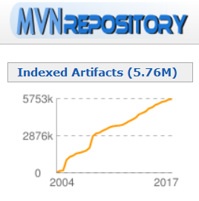
Possible extensions and applications
Create lint tools for sanity checking programmer use of annotations and domain POJOs
Move away from artifact-based build scripts
Simply specify semantic spec and the toolchain will pick an appropriate artifact (or subset of the artifact!) for you
Index a large repository of Java artifacts (e.g., MvnRepository)
Text mining/clustering on project descriptions to approximate spec (good enough for ‘jar Y does encryption’)
Code synthesis using only semantic models

